Slide 1


The Insider Risk
You Buy Monthly
POLK COUNTY SECURITY SUMMIT · OCT 9, 2026
Aware of it. Paying for it. Not watching it.
Fezz · Threat Vector Management

Slide 2
Leave with thought frameworks that last.
THE GOAL FOR TODAY
SPECIFIC ADVICE
FRAMEWORKS
Subject to change.
Generally last longer.
Products, settings and steps shift as AI moves.
Ways to think that still work when the tools change.
Shelf life: short
Shelf life: long
This is new to everyone. We're taking a stab at it here, now.
The Insider Risk You Buy Monthly
2

Slide 3
Someone hired your newest employee.
ABOUT SIX MONTHS AGO
Nobody asked you
No background check
Already has your password
Reads everything you can
Works 24/7, never takes PTO
Can't be fired, sued or prosecuted
It's been here for months. It's your AI assistant.
The Insider Risk You Buy Monthly
3

Slide 4
AI is an insider risk
THE IDEA
with extreme intelligence, no guilt, and no recourse.
Fezz · Threat Vector Management
The Insider Risk You Buy Monthly
4

Slide 5
Five sessions. One word to add: insider.
TODAY, SO FAR
COMMON LANGUAGE
SOFTWARE FACTORIES
GOVERNING AI
Add one word to it: insider.
The agents writing your code often use a developer's credentials.
Governance decides what's allowed. Identity enforces it.
AI IN THE SOC
WORKFORCE · THE BRIDGE
NOW · WALK OUT WORKING
Your SOC can detect it. Can it attribute it?
If AI is workforce, it gets what the workforce gets.
Leave with one question per move for Monday.
The Insider Risk You Buy Monthly
5

Slide 6

One way to think about securing AI.
THE MAP · HOW IT FITS TOGETHER
WHY
WHERE
CHECK
DO
MEASURE
Insider lens
Three rings
Four questions
Four moves
Eight KRIs
Treat AI like an insider. Deterrence won't work on it.
Use
Run
Ship
Access
Exposure
Action
Telemetry
Find
Badge
Box
Watch
Prompt approvals
Time to approve
Six held at zero
The Insider Risk You Buy Monthly
6

Slide 7
Point your insider program at AI.
FRAMEWORK 1 · THE INSIDER LENS
FOR PEOPLE, YOU ALREADY HAVE
AI
FOR AI, DO THIS
Hiring record
Inventory: every AI that can act, with an owner
Employee badge
Its own identity. Never a person's login
Need-to-know
Micro-permissions: least privilege per agent
Separation of duties
Micro-agent segmentation: readers can't act
Supervision
Behavior analytics on what it does
Off-boarding
Off-board it: on the checklist, with a named kill switch
The Insider Risk You Buy Monthly
7

Slide 8
Deterrence doesn't work on AI.
FRAMEWORK 2 · THE DETERRENCE GAP
DOESN'T WORK ON AI
YOUR INSIDER PROGRAM
Background checks
Accountability and consequences
Fear of getting caught
NOW CARRIES THE WHOLE LOAD
Prevention and detection.
Deterrence
Prevention
Detection
The blind spot: to your IAM, the AI is the user. Same login, same permissions, same logs. It's wearing your employee badge.
The Insider Risk You Buy Monthly
8

Slide 9
One way to think about securing AI.
THE MAP · UP NEXT
WHY
WHERE
CHECK
DO
MEASURE
Insider lens
Three rings
Four questions
Four moves
Eight KRIs
Treat AI like an insider. Deterrence won't work on it.
Use
Run
Ship
Access
Exposure
Action
Telemetry
Find
Badge
Box
Watch
Prompt approvals
Time to approve
Six held at zero
The Insider Risk You Buy Monthly
9

Slide 10

Three rings: Use, Run, Ship.
FRAMEWORK · WHERE AI LIVES
SHIP
USE
Someone else runs it. You see only what goes in and out.
RUN
Copilots, chat apps, browser extensions, notetakers
USE
RUN
AI
You run it, on your laptops or in your cloud.
Desktop and coding agents, local models, agents your teams build
SHIP
Your brand answers the public with it.
Chatbots, plugins and connectors facing customers
The Insider Risk You Buy Monthly
10

Slide 11
Who has AI inside your office suite?
USE
RUN
SHIP
HANDS UP · 1 OF 3
Copilot or Gemini in Word, Excel, Outlook or Teams.
Keep it up if it can read everything you can.
Keep it up only if you know who turned it on.
The Insider Risk You Buy Monthly
11

Slide 12
Who has an AI agent on their laptop?
USE
RUN
SHIP
HANDS UP · 2 OF 3
One that opens files and takes actions: a desktop assistant or a coding agent.
Keep it up if it runs on your login.
Keep it up only if you know its owner and its off switch.
The Insider Risk You Buy Monthly
12

Slide 13
Who has an AI your customers talk to?
USE
RUN
SHIP
HANDS UP · 3 OF 3
A chatbot, a support agent or a plugin on your site.
Keep it up if it can reach customer data.
Keep it up only if you know how many times someone tried to trick it yesterday.
The Insider Risk You Buy Monthly
13

Slide 14
One way to think about securing AI.
THE MAP · UP NEXT
WHY
WHERE
CHECK
DO
MEASURE
Insider lens
Three rings
Four questions
Four moves
Eight KRIs
Treat AI like an insider. Deterrence won't work on it.
Use
Run
Ship
Access
Exposure
Action
Telemetry
Find
Badge
Box
Watch
Prompt approvals
Time to approve
Six held at zero
The Insider Risk You Buy Monthly
14

Slide 15
Four questions, in every ring.
FRAMEWORK · WHAT TO CHECK
Access
What data can it reach?
TELEMETRY
Would you know if it went wrong?
THREE LEGS
Dangerous.
Three legs make it dangerous. A fourth, Telemetry, keeps you steady.
Exposure
Whose words will it act on?
Action
What can it change, send or promise?
Access, Exposure, Action: Simon Willison's "lethal trifecta" (2025), in our words. Telemetry is the fourth leg we add.
The Insider Risk You Buy Monthly
15

Slide 16

Three rings. Four questions.
HOW TO USE IT · EVERY RING, EVERY QUESTION
The ring tells you where to look. The four questions tell you what to check.
SHIP
ACCESS
What data can it reach?
Badge it
RUN
USE
EXPOSURE
Whose words will it act on?
Box it
AI
ACTION
What can it change, send or promise?
Box it
TELEMETRY
Would you know if it went wrong?
Watch it
The Insider Risk You Buy Monthly
16

Slide 17
One way to think about securing AI.
THE MAP · UP NEXT
WHY
WHERE
CHECK
DO
MEASURE
Insider lens
Three rings
Four questions
Four moves
Eight KRIs
Treat AI like an insider. Deterrence won't work on it.
Use
Run
Ship
Access
Exposure
Action
Telemetry
Find
Badge
Box
Watch
Prompt approvals
Time to approve
Six held at zero
The Insider Risk You Buy Monthly
17

Slide 18
Four moves: Find, Badge, Box, Watch.
FRAMEWORK · WHAT TO DO
1
2
3
4
Find it.
Badge it.
Box it.
Watch it.
Every AI that can act, with an owner.
Its own identity. Never yours.
One job, fewest tools. Never all three legs.
The deed, not the diary.
Find, Badge and Box are the design. Watch is the bridge while we learn fast.
The Insider Risk You Buy Monthly
18

Slide 19
Find it.
1 FIND
2 BADGE
3 BOX
4 WATCH
Every AI that can act, in every ring, with a human owner's name next to it.
USE
RUN
SHIP
What your people feed: copilots, chat apps, extensions.
What runs on your devices and cloud. Pin and verify it.
What answers the public in your name.
No owner's name? That's not an inventory. That's a guess.
The Insider Risk You Buy Monthly
19

Slide 20




Badge it.
1 FIND
2 BADGE
3 BOX
4 WATCH
One non-human identity per agent.
Never a person's login
Short-lived credentials
A named human owner
On the checklist for off-boarding
PICTURE THIS
The person who built the agent leaves in March. HR collects their employee badge. The agent is still running on their access in October.
The Insider Risk You Buy Monthly
20

Slide 21

Box it.
1 FIND
2 BADGE
3 BOX
4 WATCH
One agent. One job. One identity. Fewest tools.
The box rule: no single agent gets Access, Exposure and Action. Split it.
Actor agent
Reader agent
Checkpoint
data only
one way
Holds the data and can act. Never reads strangers.
Reads outside content. Can't act.
You inspect what passes. One way.
Access, Exposure, Action: Simon Willison's "lethal trifecta" (2025), in our words. The split: Beurer-Kellner et al., design patterns for securing LLM agents (2025).
The Insider Risk You Buy Monthly
21

Slide 22
Watch it.
1 FIND
2 BADGE
3 BOX
4 WATCH
Telemetry: watch the deed, not the diary.
THE DIARY: WHAT MOST LOGGING KEEPS
THE DEED: WATCH THIS
Prompts and responses. What the AI said, not what it did.
Pin its version and baseline it by identity
Alert on any drift or move outside its box
Check the result before it lands
Watch is the bridge, not the destination. We watch hard while we learn fast. Find, Badge and Box are the design.
The Insider Risk You Buy Monthly
22

Slide 23
Same tactics. The evidence moved.
1 FIND
2 BADGE
3 BOX
4 WATCH
Your MDR watches while you sleep. It only sees what you send it.
ASK: MONITOR
ASK: DETECT
ASK: RESPOND
Which of our AI logs do you take in? Endpoint, identity and Microsoft 365, not just prompts.
If we give each agent its own identity, will you baseline it like a user?
Can you suspend its account, isolate its host and block where it sends, without waiting on us?
Deciding which AI to allow stays with you. That's governance, not your MDR's job.
The Insider Risk You Buy Monthly
23

Slide 24
One way to think about securing AI.
THE MAP · UP NEXT
WHY
WHERE
CHECK
DO
MEASURE
Insider lens
Three rings
Four questions
Four moves
Eight KRIs
Treat AI like an insider. Deterrence won't work on it.
Use
Run
Ship
Access
Exposure
Action
Telemetry
Find
Badge
Box
Watch
Prompt approvals
Time to approve
Six held at zero
The Insider Risk You Buy Monthly
24

Slide 25
Three KRIs to start tracking.
MEASURE IT
97%
1.2 sec
0
AI prompt approval rate
Time to approve
Actions under a human's identity
By the 20th time people saw the same warning, the median time to dismiss it was 1.2 sec. Reading a 25-word prompt takes about 6. Flag anything faster than a read.
Prompts approved, per person and per agent. Anthropic reported 97% (Aug 2026).
The borrowed-badge problem, counted. Target: zero.
Sources: Anthropic via DevOps.com, Aug 10, 2026 · Bravo-Lillo et al., SOUPS 2014 · Brysbaert, 2019 reading-rate meta-analysis
The Insider Risk You Buy Monthly
25

Slide 26
Five more to count.
MEASURE IT
0
Agents with all three legs
Sensitive data + untrusted content + a way to send data out. That's the exfiltration path.
0
Standing or shared agent logins
Long-lived API keys and shared service accounts. Short-lived only.
0
Unvetted plugins
MCP servers, skills and plugins not from the real publisher or not pinned to a version.
0
Remembered devices
“Trusted” sessions on banking, email and password managers.
0
Text-message MFA
High-value accounts that still accept SMS or voice codes.
Targets are ours. The last two are a few settings per account.
Sources: Willison 2025 · CISA et al., Careful Adoption of Agentic AI Services, May 2026 · Koi Security (postmark-mcp), Kaspersky (OpenClaw), 2025–26 · FBI Atlanta, Nov 2024 · CISA Mobile Communications Guidance, Dec 2024
The Insider Risk You Buy Monthly
26

Slide 27
One question per move.
MONDAY
NOW
30 TO 90 DAYS
NEXT QUARTER
Badge
How many agents run on a human's login? Are agents on the off-boarding checklist?
Find
Can we list every AI that can act, in each ring, with an owner?
Watch
Do we watch what agents do, or only what they say? What's our prompt approval rate?
Box
Does any agent read outside content, touch sensitive data and act? Split it.
The Insider Risk You Buy Monthly
27

Slide 28
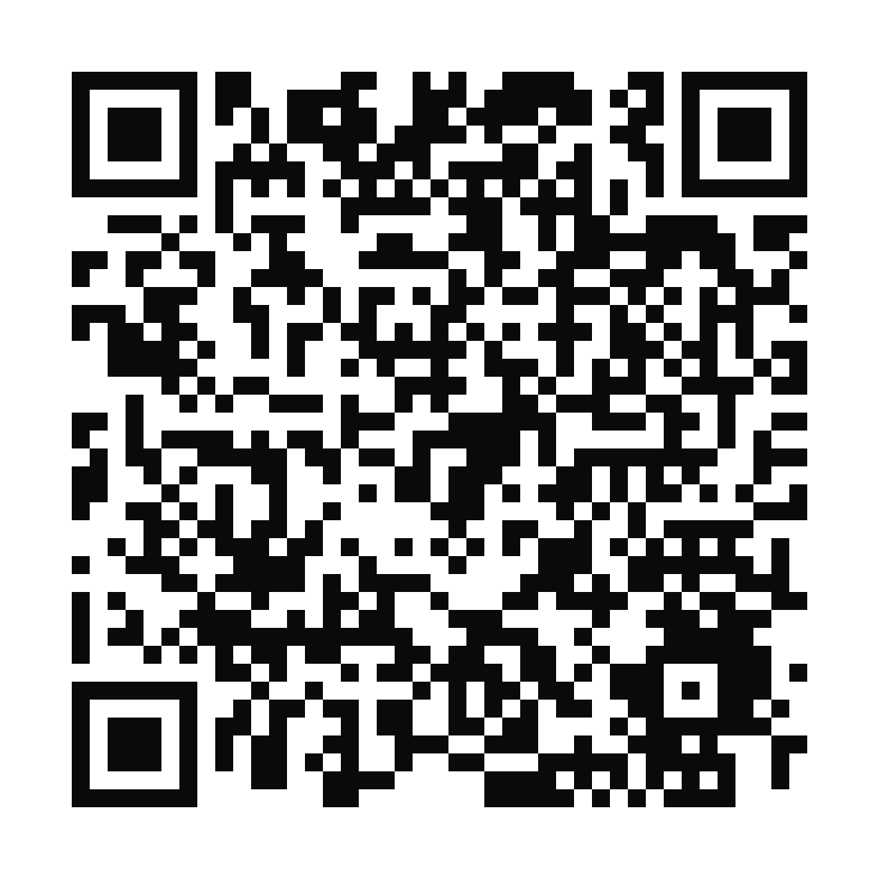
Find it. Badge it.
Box it. Watch it.
TAKE IT WITH YOU
Make it a hard target.
WHERE
Use · Run · Ship
CHECK
Access · Exposure · Action · Telemetry
DO
Find · Badge · Box · Watch
MEASURE
Prompt approvals · Time to approve · Six held at zero
This deck and every source it cites
threatvector.management/talks/polk-2026

